Slide 1
Energy Efficiency Prediction Using ML

Slide 2
Introduction
This research evaluates building heating and cooling load requirements, focusing on energy efficiency as a function of several building parameters.
Our target variable, the average energy load of a structure, will be the focus of this study to understand its components.
We use a variety of modelling methods to gain insights that help improve building energy efficiency.

Slide 3
Data Preparation & Understanding
The dataset did not contain any missing values, outliers, or data type incompatibilities.
An additional target variable was developed as part of the analysis.
This new variable represents the average of the heating load and the cooling load.
In order to simplify the study, the variables that were originally used to represent the heating load and the cooling load were eliminated.

Slide 4
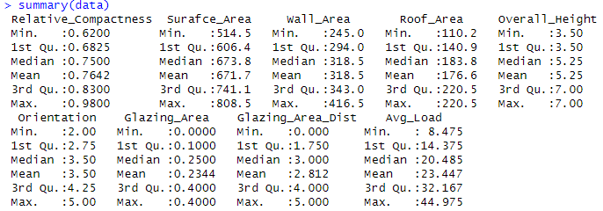
Summary Statistics
According to the summary statistics of the dataset, the average load varies greatly, with the maximum recorded average load reaching 44.975.
This indicates that the average load is highly variable.

Slide 5
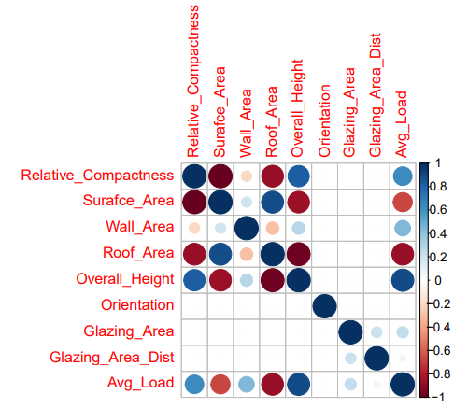
Correlation Analysis
The overall height revealed a high positive association with the average load, whereas the surface area and roof area both exhibited large negative relationships with the load.
The Wall Area variable displayed a weak positive association with the average load, however the other variables did not reveal any meaningful correlations with one another.

Slide 6
ML Models & Performance Evaluation
Linear Regression, Decision Trees, and Random Forests for analysis are trained.
Linear Regression was chosen for its simplicity and interpretability to understand predictor elements and average load.
Decision Tree data modelling captures complicated variable interactions and is more flexible and non-linear.
Multiple decision trees were averaged in Random Forests to improve prediction accuracy and avoid overfitting.
Cross validation tuned Decision Tree and Random Forest hyper parameters to improve model performance.
Each model was assessed using MAE, MSE, and R Square.

Slide 7
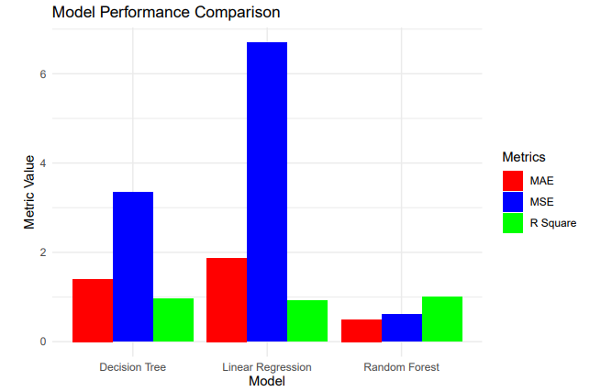
Performance of Models
The Linear Regression model had an MAE of 1.88, an MSE of 6.70, and a R Square of 0.92.
Decision Tree results indicated a significant improvement in prediction performance, with an MAE of 1.40, MSE of 3.34, and R Square of 0.96.
The Random Forest had excellent prediction accuracy with an MAE of 0.49, MSE of 0.61, and R Square of 0.99. This increase is due to its capacity to average numerous tree predictions, lowering Decision Tree variation.
Random Forests are less likely to over fit since they randomly select tree features, which improves generalization to new data.

Slide 8
Conclusion
Finally, this study showed how architectural features affect energy load requirements. As shown by the Random Forest model’s better performance than Linear Regression and Decision Trees, adopting appropriate modelling methodologies is crucial. These insights can assist architects and engineers construct energy-efficient buildings by focusing on key characteristics that affect energy loads.

